Slide 1


COREL
Council of Regional Exchange Leaders

Slide 2


COREL
Why did we need COREL?
RI
We needed a bridge and an advisory network between Rotary International (RI) and RYE Districts/Multidistricts to:
  Act & Impact: Respond swiftly and effectively to opportunities and challenges.
  Harmonise & Share: Exchange best practices and align efforts for greater synergy.
  Prevent & Solve: Anticipate issues and provide solutions when problems arise.

Slide 3
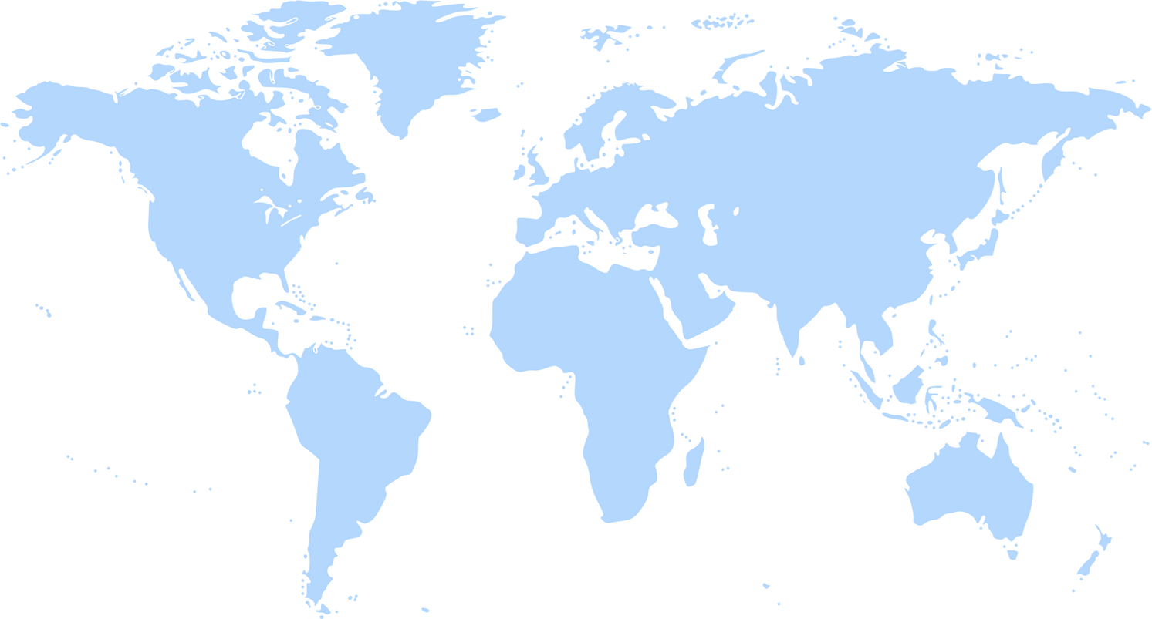








COREL
REALLYGREATSITE.COM
COREL
North America Youth Exchange Network
consists of
Europe-Eastern Mediterranean-Africa
Presidents
South Asia Youth Exchange Network
East Asia Youth Exchange Network
Immediate Past Presidents
Associação Brasileira de Intercâmbio de Jovens
Presidents-Elect
Latinoamérica Intercambio de Jóvenes de Rotary International
of regional groups
Rotary Youth Exchange Australia

Slide 4



COREL
Our Goals
Facilitate and Coordinate Cooperation among the regional leaders of Youth Exchange
Strengthen Collaboration with Rotary International.
Promote Joint Actions among regional groups and support active interaction.
Build Communication Bridges between Regional Groups, their District & Multi-Districts and Rotary International.

Slide 5
COREL
What’s Next?
Act as a Council for International Leaders
Share best practices, address regional challenges, discuss conference themes, and coordinate educational offerings.
Support Existing and Emerging Regions
Help regional groups and areas without regional groups to develop and maintain strong, effective structures.
Be the Global Voice
Represent youth exchange chairs worldwide as the de facto international youth exchange committee.
Standardise Resources
Create and maintain uniform documents for fair, efficient exchange administration.
Be the Go-To Resource
Serve as the primary international support hub for youth exchange officers.

Slide 6

COREL
COREL Committees
Focused groups dedicated to specific areas of the Youth Exchange program.
One representative from each Region participates to ensure global perspective and inclusivity.

Slide 7

COREL
Marketing Committee
Provide Guidance to Regional Groups - help them find effective ways to support their Districts and Multi-Districts.
Two-Level Communication Strategy
  Internal: For people directly involved in RYE.
  External: For Rotarians and non-Rotarians interested in learning more about RYE.
Partner with RI – Define possible guidelines and roles for conferences worldwide.
Institute-Level Engagement – Advocate for the Youth Exchange Program training to be a mandatory topic for future leaders.

Slide 8

COREL
Insurance Committee
Monitor and Harmonise – Review insurance requirements across regions and address potential issues proactively.
Learn by Doing – Adapt and refine policies based on emerging challenges (e.g., lessons learned from COVID).

Slide 9

COREL
Online Course Review
Partner with RI – Assist in creating and reviewing online courses for Youth Exchange
Learn by Doing – Empower Districts & Multidistricts – Support them in delivering these courses to everyone involved in Youth Programs worldwide.
Support Rotary Leadership – Help Regional groups ensure that DGs and DGNs. complete their mandatory learning on Youth Exchange.
Visit the Rotary Learning Centre for courses related to RYE
https://learn.rotary.org/pages/36/course-catalogs

Slide 10

COREL
Uniform Exchange Agreement
Global Harmonisation – Align application documents for all programs at a worldwide level.
Best Practice Sharing – Exchange proven approaches for visas and all pre-departure documentation.
Local Adaptation – Ensure compliance with regional laws and requirements (e.g., GDPR).

Slide 11
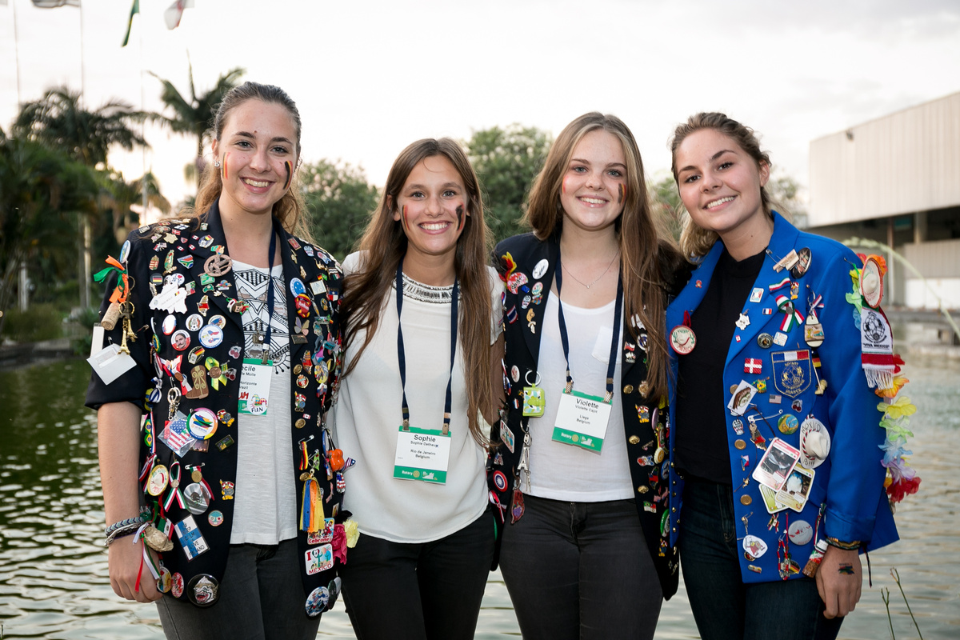

COREL
Get involved with COREL
  Have ideas, questions, or challenges? Contact COREL through your Regional Leader — we’re here to help.
  Let’s work together to strengthen Rotary Youth Exchange worldwide.
  Your input helps us innovate, harmonise, and solve problems for RYE everywhere.
We’re ready to work for you and with you
— all over the world! 🌍

